Slide 1

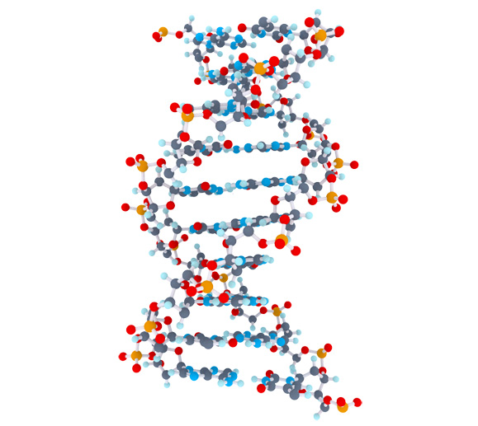
Celiac Disease Triggers
1
Matthijs Knigge

Slide 2
Overview
2
Project goal
Mendelian Randomization
Methods
Data
Pipeline
Preliminary results
Future steps

Slide 3
Project Goal
3
Inspect > 80.000 clinical parameters and molecular mechanisms to;
Identification of factors that cause or protect against Celiac Disease
Quantify the impact of causal or protective factors

Slide 4



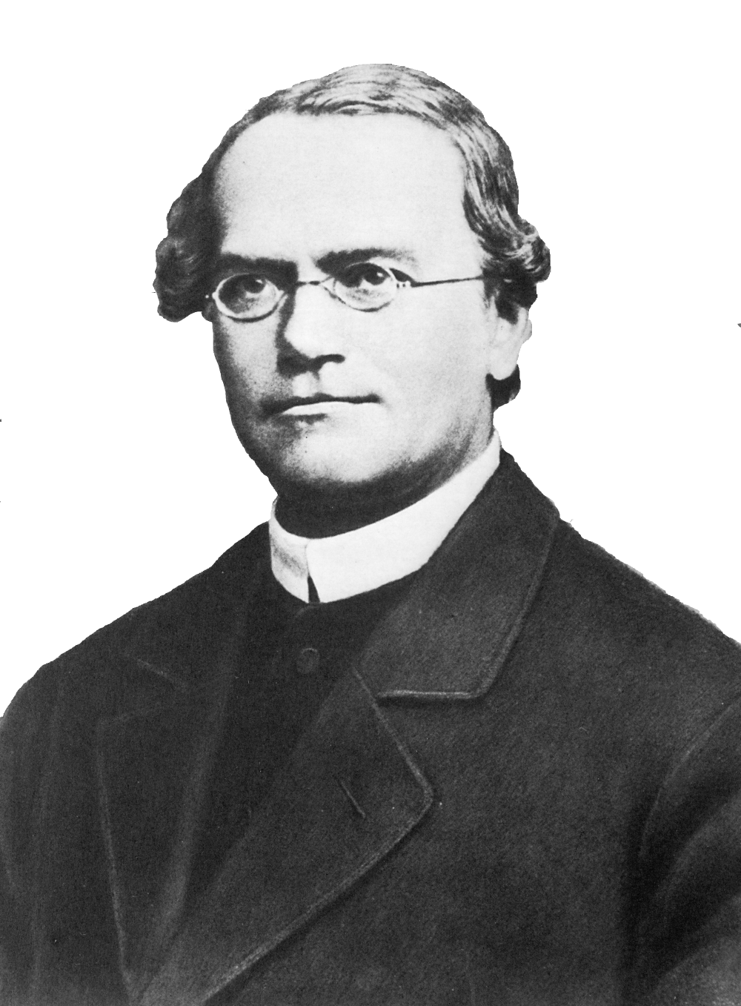







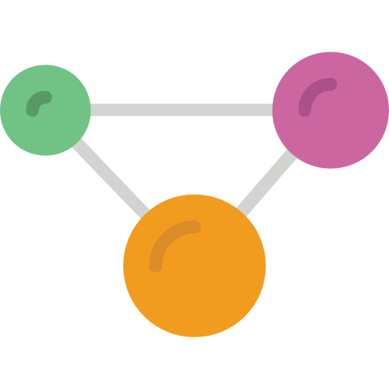


Mendelian Randomization (MR)
Randomized Controlled Trials (RCT)
4
Sample
Random assignment of subjects
Sample
Random allocation of alleles
Case
Control
Genotype
AA
Genotype
aa
Target effects
Protein effects
Outcome

Slide 5
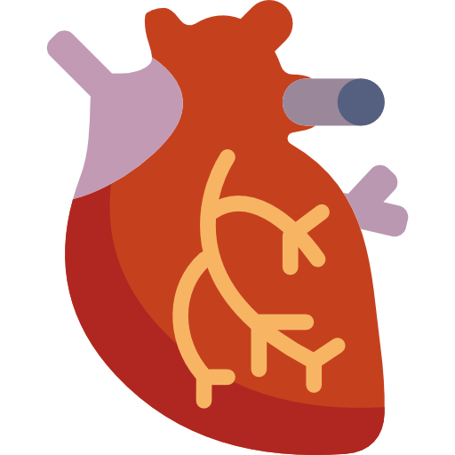

Mendelian Randomization setup
5
SNP
Exposure phenotype
Outcome phenotype
Confounders
Rules that need to be met before using a genetic variant in the MR framework
The genetic variant must be associated with the exposure of interest
The genetic variant must not be associated with confounders
The genetic variant may only affect the outcome through the exposure

Slide 6



Methods
6
Two-Sample MR | - Estimate causal effect between different samples - Summary-level data from GWAS can be used | - Cannot test for confounding - No overall causal estimate - Assumes genetic variants are uncorrelated (not in linkage disequilibrium) | - Causal estimate between genetic variants
Inverse-Variance Weighted method (IVW) | - Overall causal estimate between exposure and outcome - Summary-level data from GWAS can be used | - Assumes causal estimates provide independent evidence (no correlation) - Cannot test for confounding | - Overall causal estimate between exposure and outcome
MR-egger method | - Can be deployed when the core assumptions do not hold. - Can test for confounding (correlation between variants) - Can test for a causal effect - An estimate of the overall causal effect | - Needs 3 or more genetic variants - Assumes genetic variants are uncorrelated - Cannot distinguish between pleiotropy and a causal effect when genetic variants almost have equal estimates | - Overall causal estimate - MR-egger causal test - Overall pleiotropic effect
Bidirectional MR | - Can determine when genetic variant exhibits primary effect on the exposure, or the effect is secondary to the outcome | - difficulty in the presence of genetic variants that influence each other | - MR analysis in both directions, that ascertains direction of causal relationship

Slide 7
Data
7
 | Type | Amount of Phenotypes | Direction
Celiac, Trynka 2011 | GWAS Immunochip | 1 | Outcome
Celiac, Dubois 2010 | GWAS Immunochip | 1 | Outcome
The NHGRI-EBI GWAS catalog | Publicated GWAS | 2893 | Exposure
MRbase Metabolite | GWAS on metabolites in whole blood | 121 | Exposure
MRbase Proteins | GWAS on protein levels whole blood | 47 | Exposure
MRbase Gene Expression levels (GTEX) | GWAS on gene identifiers in 44 different tissues | 32432 | Exposure
MRbase Methylation levels | GWAS on methylation levels in whole blood across 5 time points | 33256 | Exposure
additional downloaded GWAS | GWAS | 1308 | Exposure
UK.BIOBANK | GWAS | 778 | Exposure
Gene expression | GWAS | 9744 | Exposure
pQTL | GWAS | 198 | Exposure
Total | 80779

Slide 8
Pipeline
8
SNP | effect_allele | beta | se | p
rs61733845 | T | 0.03536714 | 0.04432255 | 2.465e-06
rs1320571 | A | 0.01882175 | 0.04265126 | 6.590e-01
.... | .... | …. | …. | ….
GWAS
Celiac 2011. Gosia Trynka et al.
SNP | effect_allele | beta | se | p
rs314253 | C | -0.0201900 | 0.002646 | 2.471e-14
rs7775397 | G | -0.0369352 | 0.004845 | 2.721e-14
.... | …. | …. | …. | ….
GWAS
HDL, LDL, Triglycerides. Willer CJ et al. Discovery and refinement of loci associated with lipid levels. Nat. Genet. 2013. doi:10.1038/ng.2797
Outcome = Celiac Disease, Exposure = HDL, LDL, Triglycerides

Slide 9
Pipeline
9
Data input
Operation
GWAS exposure
Select genome-wide significance on exposure
First core assumption
Remove variants without Beta/Log odds on exposure
1000 Genomes
Query missing alleles by reference on exposure
GWAS outcome
Find overlap between exposure and outcome
Harmonize Outcome on Exposure
HLA region removed
- Positive align exposure
- Align outcome on exposure
- Remove palindromic SNPs

Slide 10


Data input
Operation
10
GWAS exposure
GWAS outcome
Clumping for proxy SNPs with PLINK
Second core assumption
Perform Wald-method
Perform Inverse-Variance Weighted method
Perform MR-egger method
Perform Cochran's Q test
Third core assumption
Perform Bidirectional MR
- Outcome becomes exposure
- Exposure becomes outcome
https://bitbucket.org/MatthijsKnigge/mendelianrandomization.git

Slide 11


Preliminary results
11
Direction: Celiac ~ Exposure
Considerd FDR < .05 for MR-egger | IVW
Direction: Exposure ~ Celiac
Considerd FDR < .05 for MR-egger | IVW
185
209
145
114
32
19
Celiac 2010
Celiac 2011
Celiac 2010
Celiac 2011
Overlap
Overlap

Slide 12
Preliminary results, Forward
12
Celiac 2011, Gosia Trynka et al. ~ Exposure
185 significant potential exposures
Top 10
Exposure | IVW | Egger | nSNP
T1D_meta_2015_25751624_hg19 | 1.455825e-24 | 6.978655e-01 | 56
Type1 Diabetes | 2.467783e-20 | 6.982018e-01 | 50
Inflammatory Bowel Disease | 1.698417e-11 | 6.096369e-01 | 59
Ulcerative colitis | 2.142757e-10 | 5.890897e-02 | 36
Crohns disease | 3.229960e-10 | 7.074762e-01 | 48
plateletcrit | 5.768434e-10 | 4.884381e-08 | 67
IL18RAP | 9.457623e-10 | 9.280580e-01 | 9
lymphocytes count | 1.914990e-09 | 6.584747e-01 | 61
platelet count | 4.433270e-09 | 4.835657e-06 | 77
Packed cell volume | 7.589489e-09 | 3.143014e-01 | 5

Slide 13
Preliminary results, Reverse
13
Exposure ~ Celiac 2011, Gosia Trynka et al.
209 significant potential exposures
Top 10
Exposure | IVW | Egger | nSNP
Platelet crit | 3.575738e-66 | 9.174225e-01 | 48
thyroid problem (not cancer) | 8.414018e-60 | 3.193874e-01 | 48
Platelet count | 2.033008e-51 | 4.996859e-01 | 48
T1D_meta_2015_25751624_hg19 | 7.136551e-50 | 6.925841e-01 | 48
Type1 Diabetes | 2.826052e-45 | 8.576514e-01 | 48
Eosinophill count | 5.173730e-38 | 9.888424e-01 | 48
Ease of skin tanning | 4.506061e-36 | 6.760805e-15 | 48
Lymphocyte percentage | 8.730661e-36 | 2.770322e-01 | 48
Inflammatory Bowel Disease | 3.094949e-34 | 5.491841e-01 | 48
E03 Other hypothyroidism | 1.727432e-33 | 5.923195e-01 | 48

Slide 14
Preliminary results
14
Celiac 2010, Patrick Dubois et al. ~ Exposure
32 significant potential exposures
Top 10
Exposure | IVW | Egger | nSNP
T1D_meta_2015_25751624_hg19 | 8.154147e-21 | 6.682035e-01 | 33
Type1 Diabetes | 7.131549e-19 | 5.441627e-01 | 26
Inflammatory Bowel Disease | 7.092205e-05 | 9.985827e-01 | 42
Ulcerative colitis | 5.904139e-04 | 7.836626e-01 | 27
Primary biliary cirrhosis | 6.324192e-04 | 9.985827e-01 | 20
Coronary artery disease mi additive | 2.032062e-03 | 9.869497e-01 | 15
Crohns disease | 2.816389e-03 | 9.985827e-01 | 36
eosinophils+basophils count | 9.680962e-03 | 6.728569e-01 | 161
eosinophils count | 1.797706e-02 | 7.925704e-01 | 166
plateletcrit | 1.558333e-01 | 2.015023e-03 | 198

Slide 15
Preliminary results
15
Exposure ~ Celiac 2010, Patrick Dubois et al.
145 significant potential exposures
Top 10
Exposure | IVW | Egger | nSNP
K90 Intestinal malabsorption | 5.812490e-63 | 0.3689493413 | 10
Platelet crit | 4.181290e-51 | 0.0001414908 | 10
thyroid problem (not cancer) | 2.466238e-42 | 0.0976389945 | 10
Platelet count | 9.184329e-40 | 0.0001414908 | 10
Eosinophill count | 1.092300e-26 | 0.0004678592 | 10
E03 Other hypothyroidism | 2.466970e-23 | 0.6321703636 | 10
E00-E07 Disorders of thyroid gland | 2.754765e-20 | 0.6321703636 | 10
Eosinophill percentage | 1.102760e-17 | 0.0011727342 | 10
K90-K93 Other diseases of the digestive system | 2.370714e-17 | 0.9673294238 | 10
Inflammatory Bowel Disease | 3.222523e-16 | 0.6983328248 | 10

Slide 16
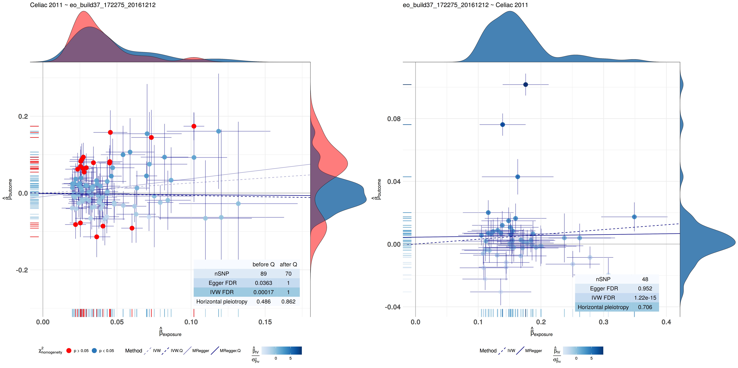
Preliminary results Bidirectional MR
16
Celiac 2011, Gosia Trynka et al.

Slide 17
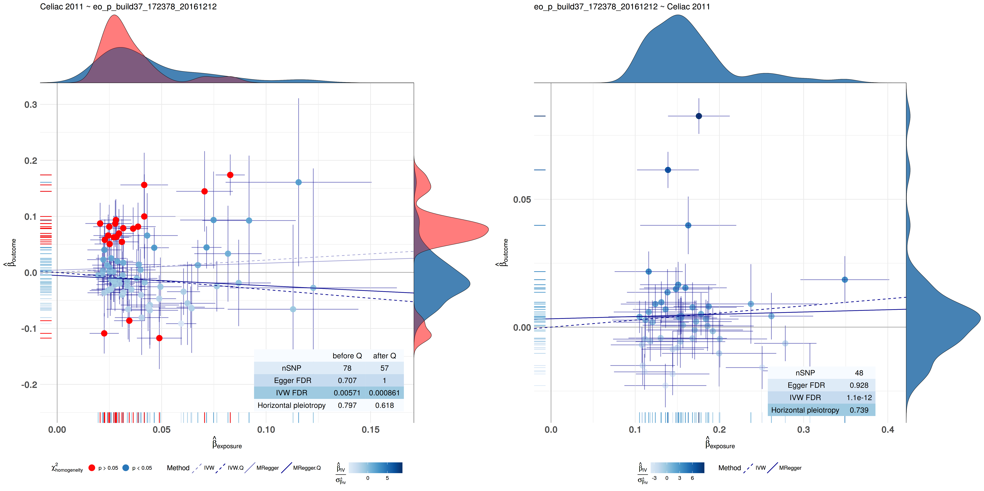
Preliminary results Bidirectional MR
17
Celiac 2011, Gosia Trynka et al.

Slide 18
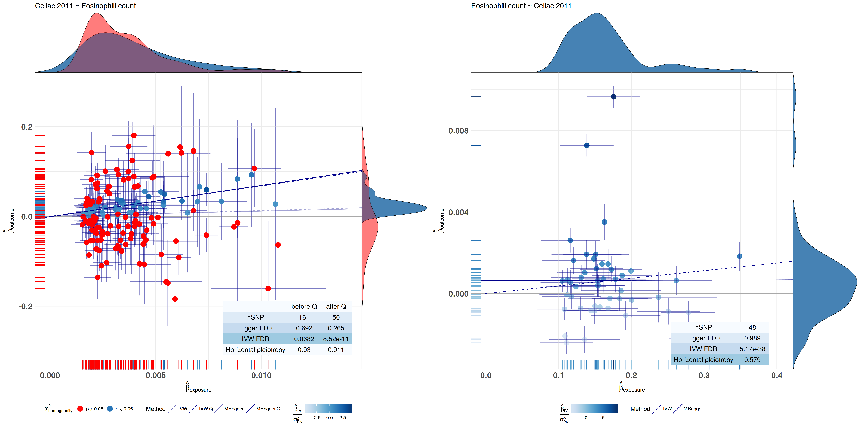
Preliminary results Bidirectional MR
18
Celiac 2011, Gosia Trynka et al.

Slide 19
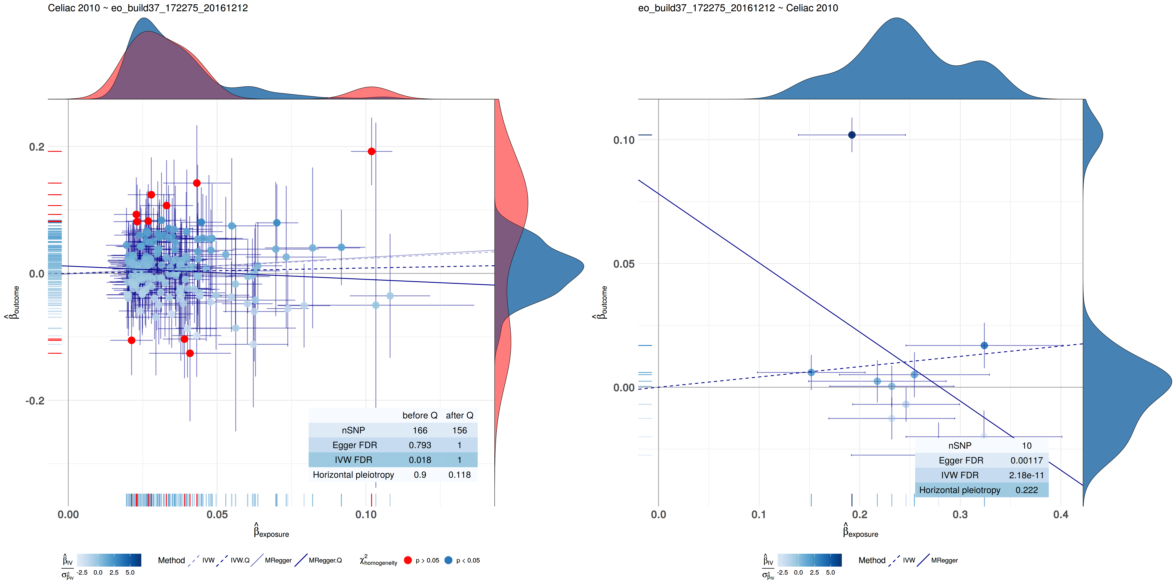
Preliminary results Bidirectional MR
19
Celiac 2010, Patrick Dubois et al.

Slide 20
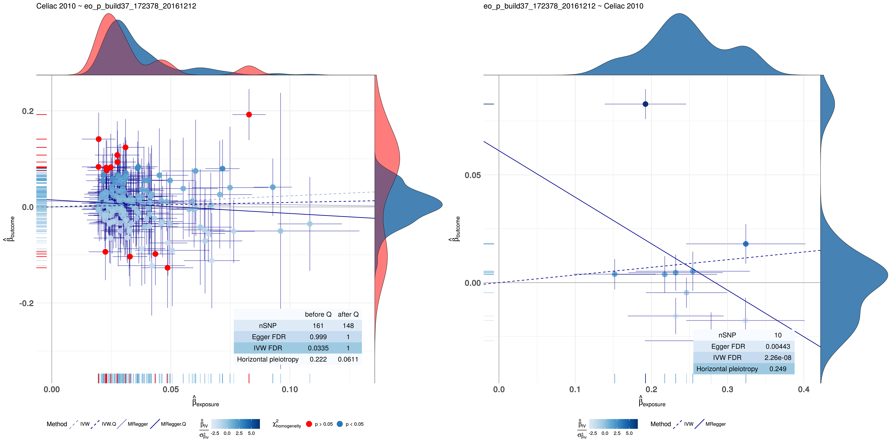
Preliminary results Bidirectional MR
20
Celiac 2010, Patrick Dubois et al.

Slide 21
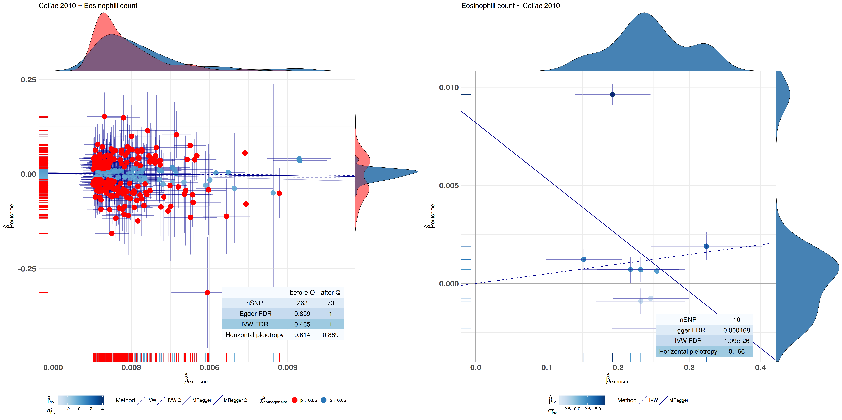
Preliminary results Bidirectional MR
21
Celiac 2010, Patrick Dubois et al.

Slide 22
Conclusions
22
Celiac 2011, Gosia Trynka et al. ~ Exposure
Phenotype | Conslusion
T1D_meta_2015_25751624_hg19 | lower risk for Type 1 Diabetes protects for Celiac Disease
Type 1 Diabetes | lower risk for Type 1 Diabetes protects for Celiac Disease
Inflammatory Bowel Disease | lower risk for Inflammatory Bowel Disease protects for Celiac Disease
Ulcerative colitis | lower risk for Ulcerative colitis protects for Celiac Disease
Crohns disease | lower risk for Crohns Disease protects for Celiac Disease
plateletcrit | higher level of plateletcrit protects for Celiac Disease
IL18RAP | higher level of IL18RAP protects for Celiac Disease
lymphocytes count | higher level of lymphocytes count protects for Celiac Disease
platelet count | lower level of platelet count protects for Celiac Disease
Packed cell volume | lower lever of packed cell volume protects for Celiac Disease

Slide 23
Conclusions
23
Celiac 2010, Patrick Dubois et al. ~ Exposure
Phenotype | Conslusion
T1D_meta_2015_25751624_hg19 | lower risk for Type 1 Diabetes protects for Celiac Disease
Type1 Diabetes | lower risk for Type 1 Diabetes protects for Celiac Disease
Inflammatory Bowel Disease | lower risk for Inflammatory Bowel Disease protects for Celiac Disease
Ulcerative colitis | lower risk for Ulcerative colitis protects for Celiac Disease
Primary biliary cirrhosis | lower risk for Primary biliary cirrhosis protects for Celiac Disease
Coronary artery disease mi additive | lower risk for Coronary artery disease protects for Celiac Disease
Crohns disease | lower risk for Crohns Disease protects for Celiac Disease
eosinophils+basophils count | Seemingly a lower level of eosinophils+basophils count protects for Celiac Disease but this is driven by a subset of SNPs !!!!!!!!!!!!!!!!!!!!!!!!!!!!!!
eosinophils count | Seemingly a lower level of eosinophils count protects for Celiac Disease but this is driven by outliers
platelet count | Seemingly a lower level of platelet count protects for Celiac Disease but this is driven by outliers

Slide 24
Future steps
24
Use PreventCD cohort to validate by predicting causal or protective factors identified
Pathway analysis on SNPs in significant hits
Network Mendelian Randomization

